Slide 1

DATA Analyst Jobs data exploration and insights
Presenter: Samandar Singh

Slide 2
Project Overview
Objectives, Approach and Dataset Information
Objective: Explore Data Analyst Jobs Dataset to uncover insights related to Data Analyst Job Market
Approach: Data Cleaning, Visualization and statistical analysis.
Dataset Shape: (2252, 13)
Key Columns: Job Title, Company Name, Location, Headquarters, Size, Type of ownership, Industry, Sector and Revenue.
Initial Handling: Removed Missing and duplicate values, Data Conversions and removing unwanted columns.

Slide 3
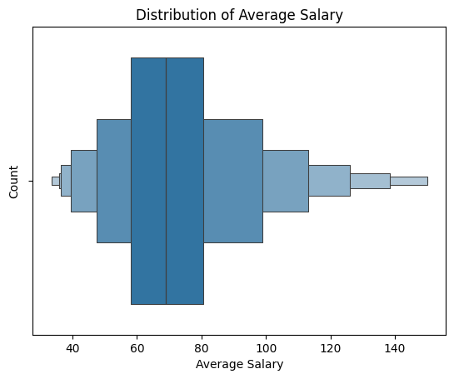
Finding 1
Distribution of Average Salary
Visualization: Histogram Plot Showing Salary Distribution.
Insights: The average salary for data analyst jobs is between 60K-80K annually with a minimum of 40K and Maximum of 140K.

Slide 4
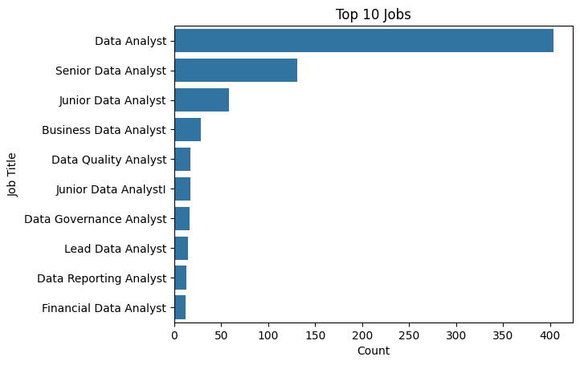
Finding 2
Job Titles
Visualization: Bar Chart showing Top 10 Job Titles
Insights: Most Jobs are available for Data Analyst, Junior Data Analyst and Senior Data Analyst.

Slide 5
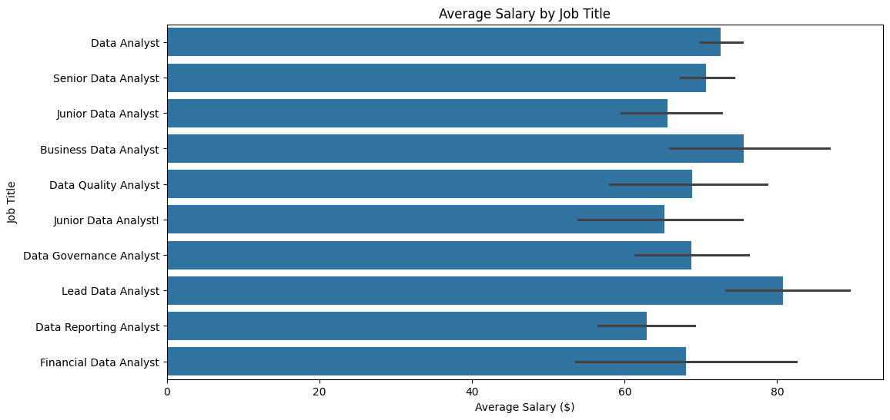
Finding 3
Average Salary by Job Titles
Visualization: Bar Chart showing Average Salary of each Job Title.
Insights: Data Analysts are paid on an average between 60,000-80,000 per year. The dataset also shows that the highest-paying job in the industry is Lead Data Analyst, which pays above 80,000 per year but lacks job availability.

Slide 6
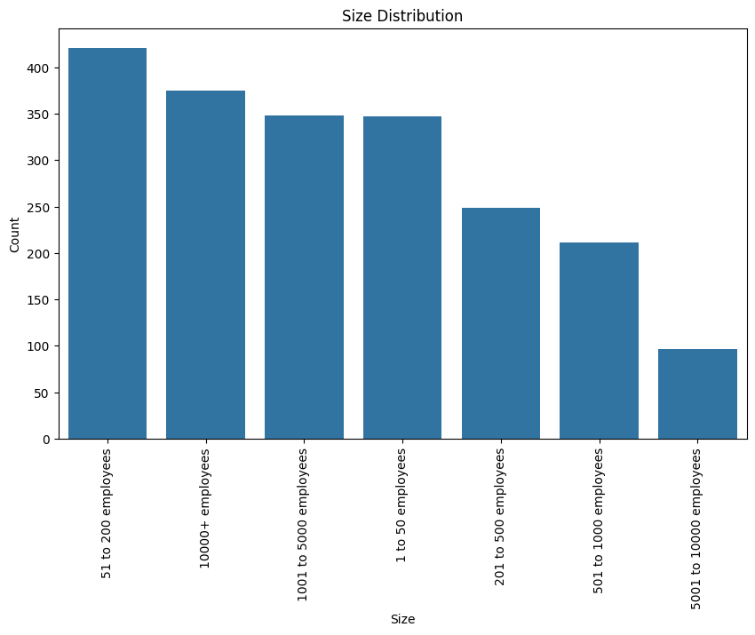
Finding 4
Companies by amount of Employees
Visualization: Column Chart showing Companies by amount of employees.
Insights: Based on the data, there are not a lot of companies that has 5000-10000 employees in the Data Analytics Industry. On the other hand the company that has more that 10000 employees has more than 350 which falls on 2nd place. The company size that has the most value counted is the company that has 51-200.

Slide 7
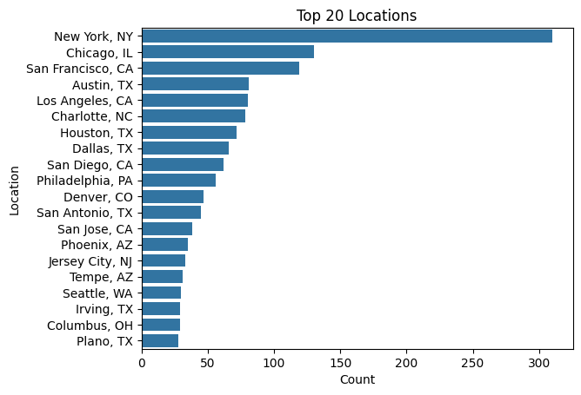
Finding 5
Top 20 Locations among Interviewed
Visualization: Bar Chart showing top location where data analyst is getting hired.
Insight 1: The dataset showed that the top locations and headquarters are the same. The job openings in New York is significantly higher compare to the job in Chicago.
Insight 2: Looking at the salary correlation the top 5 locations that has a higher salary are all located in California.

Slide 8
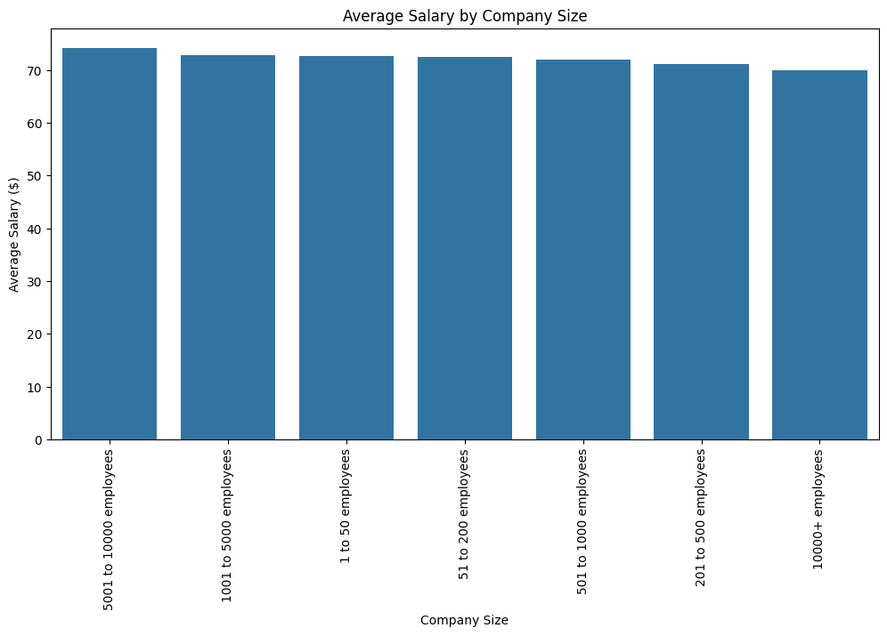
Finding 6
Average Salary by Company Size
Visualization: Column Chart showing Salary distribution by size of company.
Size of a company is not much affecting salary of data analyst perhaps salary depends on the market.

Slide 9
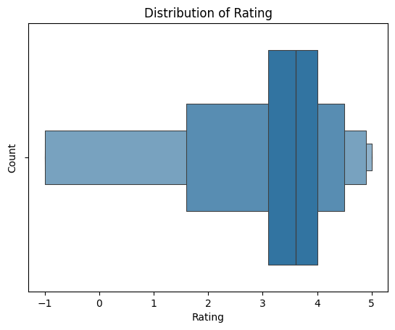
Finding 7
Company Rating
Visualization: Histogram showing rating of all types of companies.
Insight: The rating shows that the rating is between 3.0- 4.0 meaning that there is a data analyst jobs rating is fairly average.

Slide 10
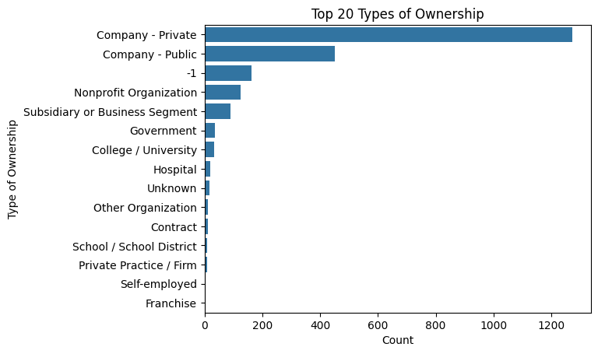
Finding 8
Type of Ownership
Visualization: Showing different type of company ownerships.
Insight: A significant amount of data falls on the Private sector, followed by public sector

Slide 11
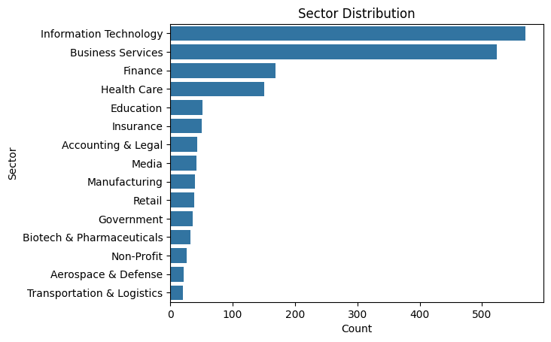
Finding 9
Sector Distribution
Visualization: Bar Chart Showing Different types of sectors.
Insight: A significant amount of data falls on the Private sector, followed by public sector

Slide 12
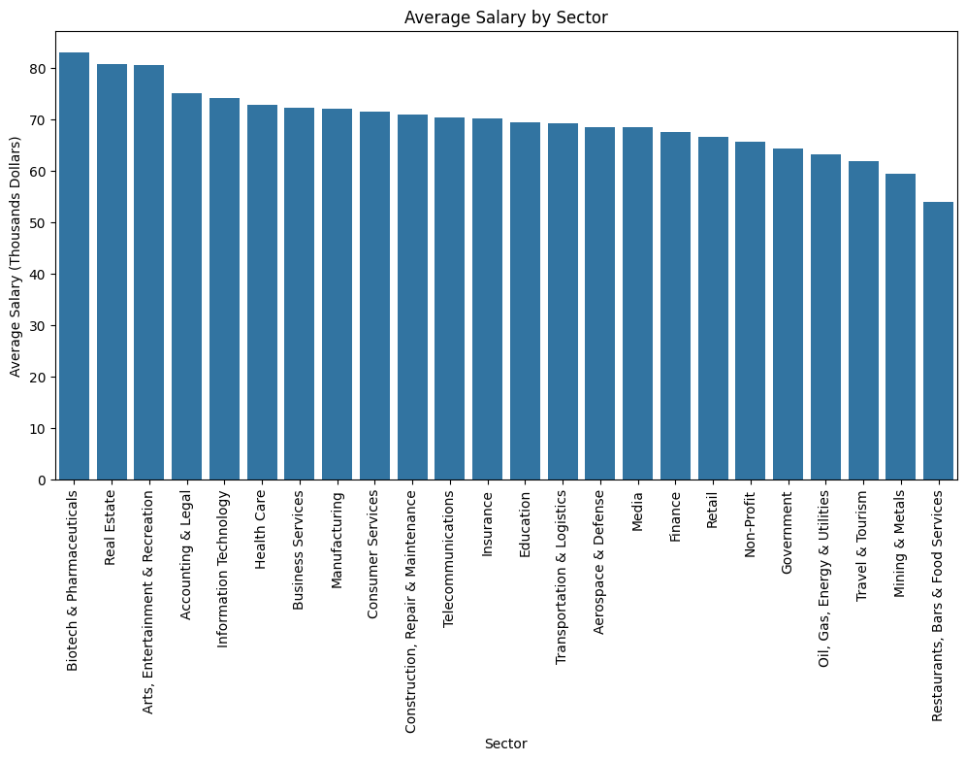
Finding 10
Average Salary By Sector
Visualization: Bar Chart Showing average salary by different sectors.
Insight: Information Technology and Business Services dominated the sector distribution. On the contrary, in correlation with the average salary, the information technology only fell at the 5th place where the average salary is between 70K-75K annually. Biotech & Pharmaceuticals showed that this sector is the highest paying sector which pays more than 80K annually.

Slide 13
The END

